Slide 1

Chapter 5
IPv4 Addresses
Copyright © The McGraw-Hill Companies, Inc. Permission required for reproduction or display.

Slide 2
Figure 4.12 An imaginary part of the Internet
Notes:
上一章介绍了各样的接入网和广域网，如LAN，WLAN，P2P，ATM等，这形成了Internet的基础，Internet是网际互连网，就是各样网络的集合，那么如何实现这些异构网络之间的相互通信呢？

Slide 3
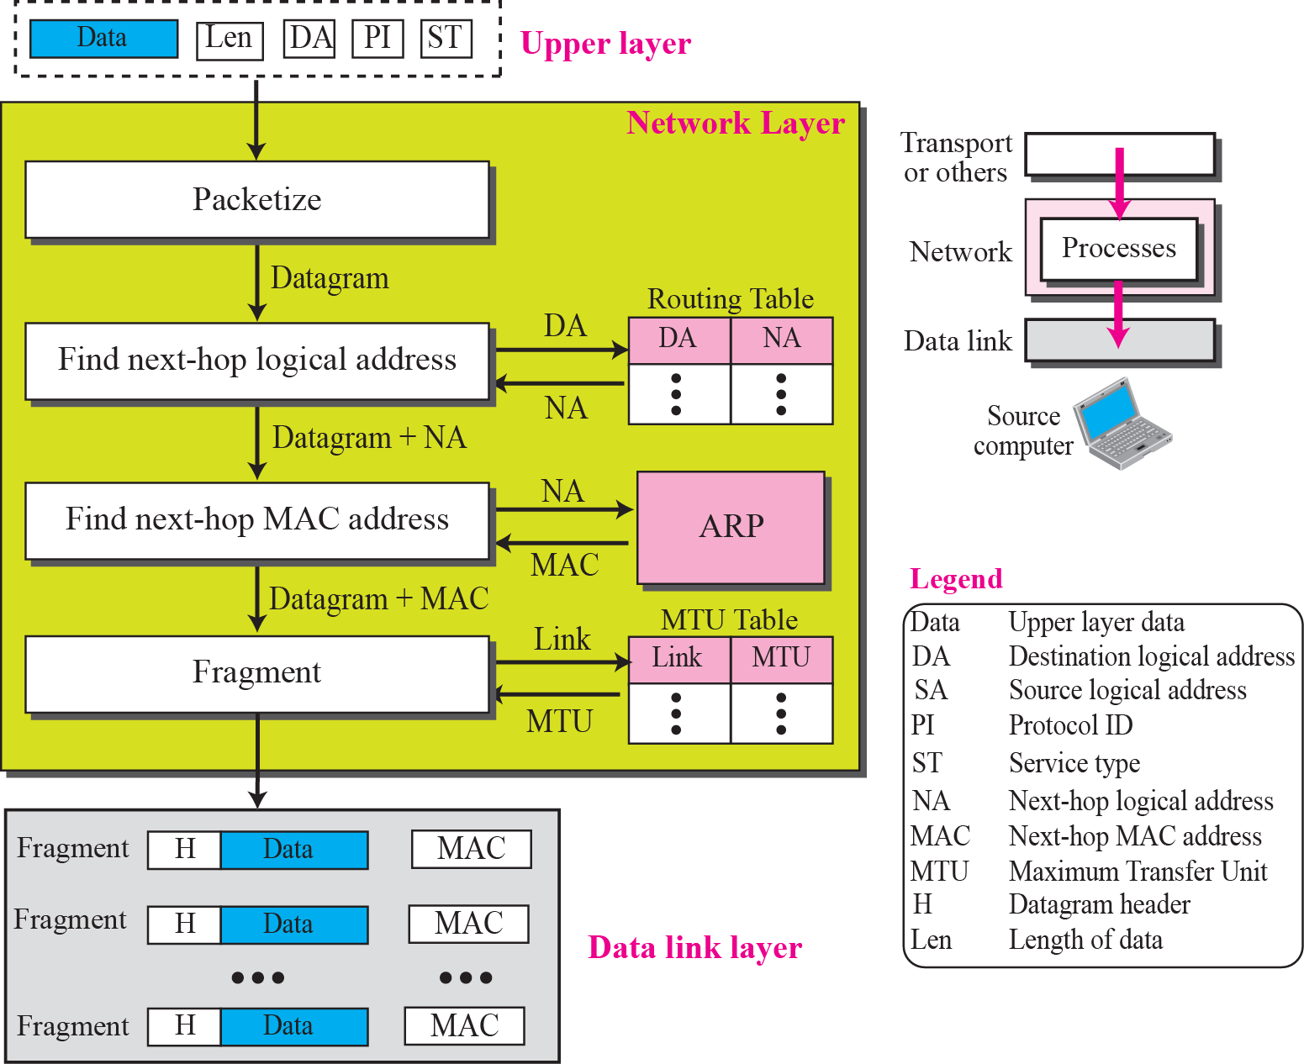
Figure 4.13 Services provided at the source computer
Notes:
从分层的角度来说，要把每一跳之间 通过MAC地址进行通信的行为视为基本单元， 在其之上有一个逻辑连接层，就是网络层，这个逻辑层标识起点和终点地址，并能通过地址映射表在每一跳实现逻辑地址到物理地址的转换

Slide 4
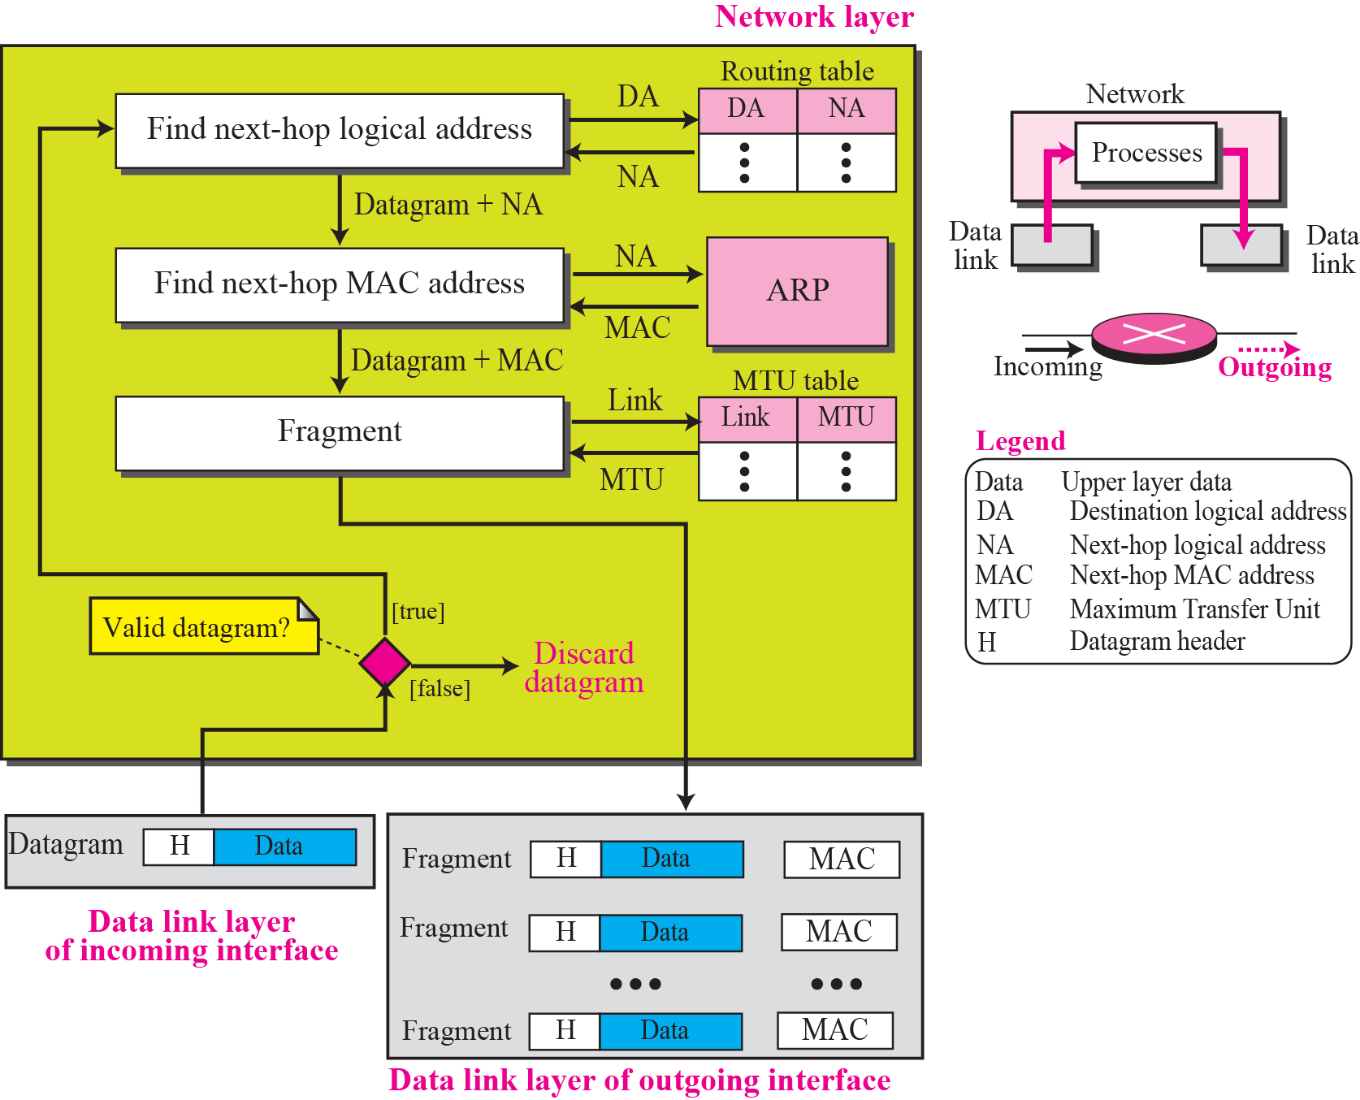
Figure 4.14 Processing at each router
Notes:
通过这种地址映射，在网络中间的每一个设备上才能实现正确的寻路

Slide 5
How To manage the logical address of every network？

Slide 6
Chapter Outline
5.1 Introduction
5.2 Classful Addressing
5.3 Classless Addressing
5.4 Special Addresses
5.5 NAT
Notes:
其中，最典型也是目前主流的就是IP协议

Slide 7
5-1 INTRODUCTION
The identifier used in the IP layer of the TCP/IP protocol suite to identify each device connected to the Internet is called the Internet address or IP address. An IPv4 address is a 32-bit address that uniquely and universally defines the connection of a host or a router to the Internet; an IP address is the address of the interface.
Notes:
IP协议通过长度为32bits 的地址进行设备标识，为什么是32bits？ 一方面是当时CPU总线宽度，另一方面是相较于MAC地址48bits，其可以更短

Slide 8
Topics Discussed in the Section
Notation
Range of Addresses
Operations

Slide 9

Note
An IPv4 address is 32 bits long.
Note
The IPv4 addresses are unique and universal.

Slide 10
Note
The address space of IPv4 is 2³² or 4,294,967,296.

Slide 11
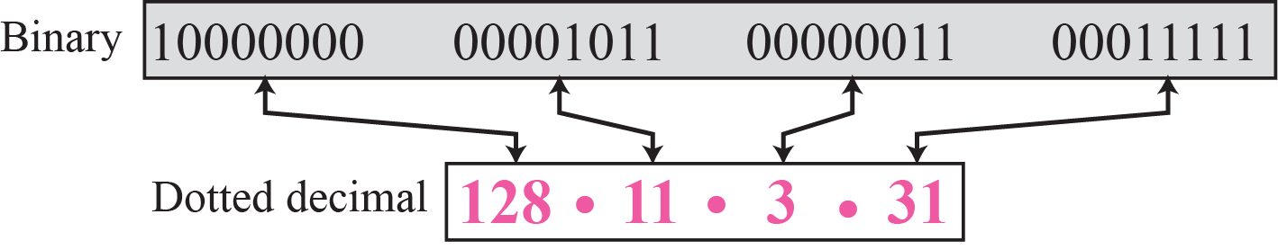
Figure 5.1 Dotted-decimal notation

Slide 12
Example 5.1
Change the following IPv4 addresses from binary notation to dotted-decimal notation.
a. 10000001 00001011 00001011 11101111
b. 11000001 10000011 00011011 11111111
c. 11100111 11011011 10001011 01101111
d. 11111001 10011011 11111011 00001111
Solution
We replace each group of 8 bits with its equivalent decimal number (see Appendix B) and add dots for separation:
a. 129.11.11.239
b. 193.131.27.255
c. 231.219.139.111
d. 249.155.251.15

Slide 13
Example 5.2
Change the following IPv4 addresses from dotted-decimal notation to binary notation.
a. 111.56.45.78
b. 221.34.7.82
c. 241.8.56.12
d. 75.45.34.78
Solution
We replace each decimal number with its binary equivalent:
a. 01101111 00111000 00101101 01001110
b. 11011101 00100010 00000111 01010010
c. 11110001 00001000 00111000 00001100
d. 01001011 00101101 00100010 01001110

Slide 14
Example 5.5
Find the number of addresses in a range if the first address is 146.102.29.0 and the last address is 146.102.32.255.
Solution
We can subtract the first address from the last address in base 256 (see Appendix B). The result is 0.0.3.255 in this base. To find the number of addresses in the range (in decimal), we convert this number to base 10 and add 1 to the result..

Slide 15
Example 5.6
The first address in a range of addresses is 14.11.45.96. If the number of addresses in the range is 32, what is the last address?
Solution
We convert the number of addresses minus 1 to base 256, which is 0.0.0.31. We then add it to the first address to get the last address. Addition is in base 256.

Slide 16
Chapter Outline
5.1 Introduction
5.2 Classful Addressing
5.3 Classless Addressing
5.4 Special Addresses
5.5 NAT

Slide 17
5-2 CLASSFUL ADDRESSING
IP addresses, when started a few decades ago, used the concept of classes. This architecture is called classful addressing. In the mid-1990s, a new architecture, called classless addressing, was introduced that supersedes the original architecture. In this section, we introduce classful addressing because it paves the way for understanding classless addressing and justifies the rationale for moving to the new architecture. Classless addressing is discussed in the next section.

Slide 18
Topics Discussed in the Section
Classes
Classes and Blocks
Two-Level Addressing
Three-Level Addressing: Subnetting
Supernetting

Slide 19
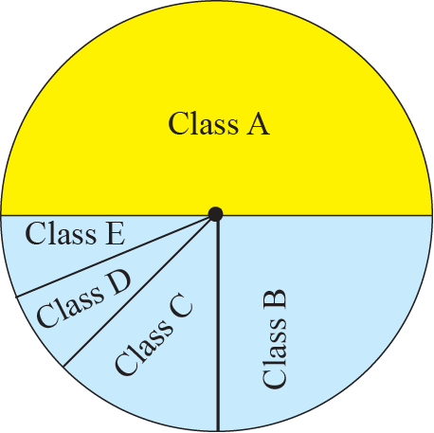
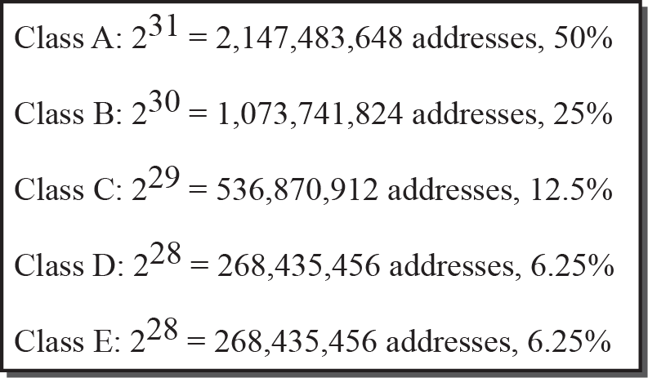
Figure 5.5 Occupation of address space
Notes:
一开始，通过规划的方式，分为5类

Slide 20
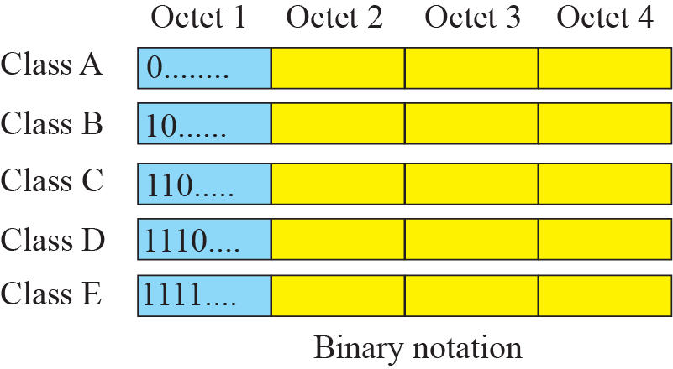
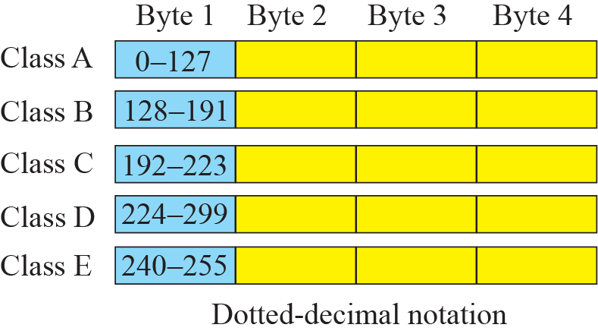
Figure 5.6 Finding the class of address

Slide 21
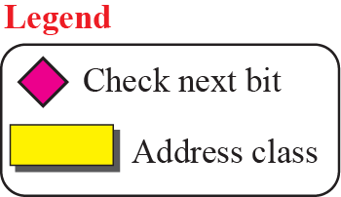
Figure 5.7 Finding the class of an address using continuous checking

Slide 22
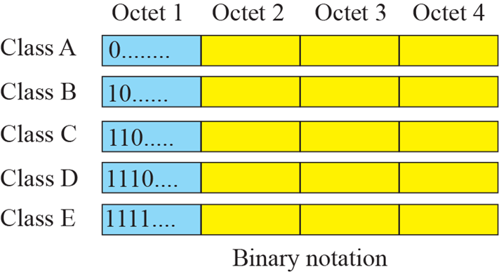
Example 5.10
Find the class of each address:
a. 00000001 00001011 00001011 11101111
b. 11000001 10000011 00011011 11111111
c. 10100111 11011011 10001011 01101111
d. 11110011 10011011 11111011 00001111
Solution
See the procedure in Figure 5.7.
a. The first bit is 0. This is a class A address.
b. The first 2 bits are 1; the third bit is 0. This is a class C address.
c. The first bit is 1; the second bit is 0. This is a class B address.
d. The first 4 bits are 1s. This is a class E address.

Slide 23

Example 5.11
Find the class of each address:
a. 227.12.14.87
b. 193.14.56.22
c. 14.23.120.8
d. 252.5.15.111
Solution
a. The first byte is 227 (between 224 and 239); the class is D.
b. The first byte is 193 (between 192 and 223); the class is C.
c. The first byte is 14 (between 0 and 127); the class is A.
d. The first byte is 252 (between 240 and 255); the class is E.

Slide 24
Figure 5.8 Netid and hostid
Notes:
IP地址又分为网络地址和主机地址两部分，其中A类地址网络地址为1个字节，主机地址为3个字节

Slide 25
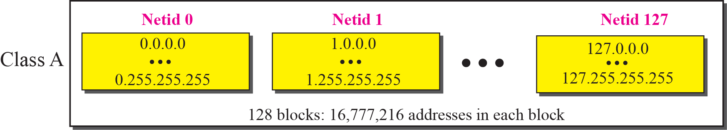
Figure 5.9 Blocks in Class A
Notes:
所以，A类地址又分为128个网络，可以分配给128个用户

Slide 26
Note
Millions of class A addresses are wasted.
Notes:
因为每个用户有16,777,216个主机地址可分配，且每个主机有一个唯一的IP，其导致极大的浪费

Slide 27
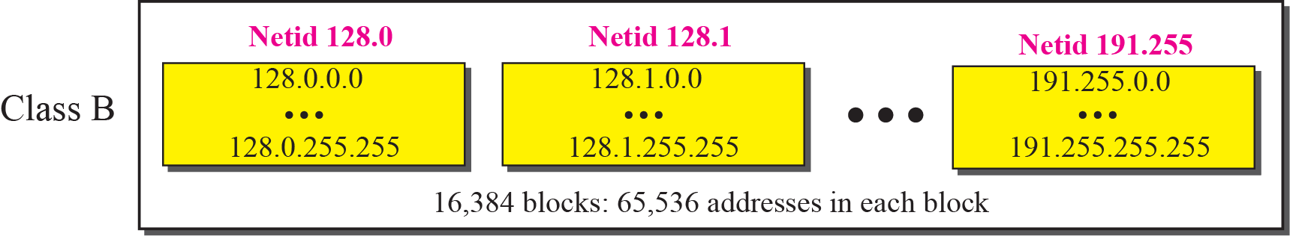
Figure 5.10 Blocks in Class B
Notes:
同理，B类地址有16384个，每个地址中有65536个主机地址

Slide 28
Note
Many class B addresses are wasted.
Notes:
B类地址也存在着浪费

Slide 29
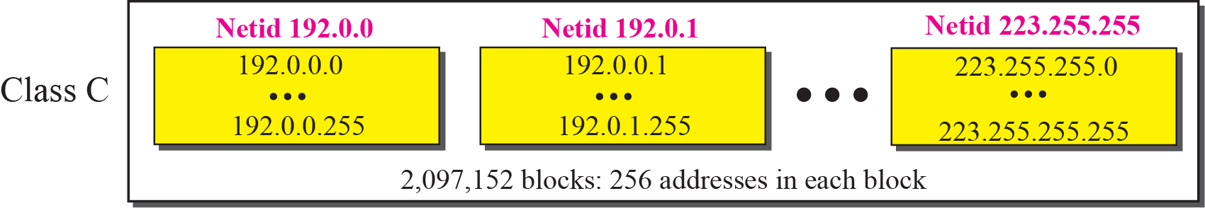
Figure 5.11 Blocks in Class C
Notes:
Netid 的长度变为3个字节，每个block中的地址数变为256个

Slide 30
Note
Not so many organizations are so small to have a class C block.

Slide 31
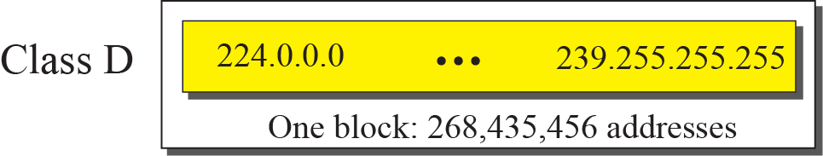
Figure 5.12 The single block in Class D

Slide 32
Note
Class D addresses are made of one block, used for multicasting.

Slide 33
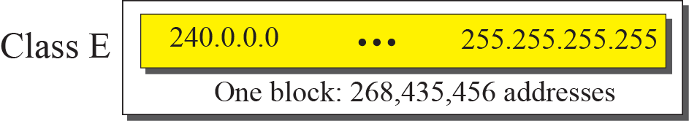
Figure 5.13 The single block in Class E

Slide 34
Note
The only block of class E addresses was reserved for future purposes.

Slide 35
Note
The range of addresses allocated to an organization in classful addressing
was a block of addresses in
Class A, B, or C.
Notes:
所有用户的地址分配都是按分类地址中A/B/C的一个地址为基本单元的

Slide 36
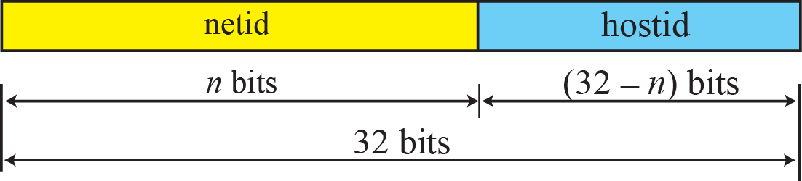
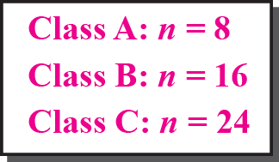
Figure 5.14 Two-level addressing in classful addressing

Slide 37
Example 5.12

Slide 38
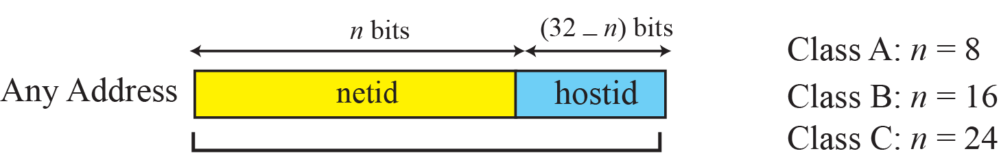
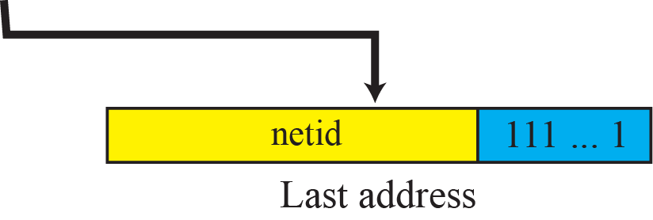
Figure 5.15 Information extraction in classful addressing

Slide 39
Example 5.13
An address in a block is given as 73.22.17.25. Find the number of addresses in the block, the first address, and the last address.
Solution
Figure 5.16 shows a possible configuration of the network that uses this block.
1. The number of addresses in this block is N = 2^{32−n} = 16,777,216.
2. To find the first address, we keep the leftmost 8 bits and set the rightmost 24 bits all to 0s. The first address is 73.0.0.0/8, in which 8 is the value of n.
3. To find the last address, we keep the leftmost 8 bits and set the rightmost 24 bits all to 1s. The last address is 73.255.255.255.
Notes:
最高字节0~127 A类地址

Slide 40
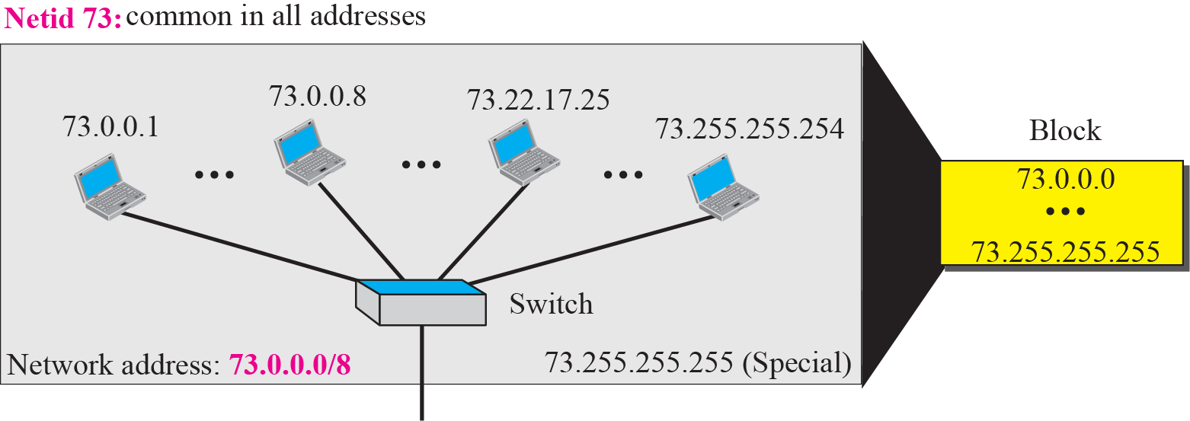
Figure 5.16 Solution to Example 5.13

Slide 41
Example 5.14
An address in a block is given as 180.8.17.9. Find the number of addresses in the block, the first address, and the last address.
Solution
Figure 5.17 shows a possible configuration of the network that uses this block.
1. The number of addresses in this block is N = 2^{32−n} = 65,536.
2. To find the first address, we keep the leftmost 16 bits and set the rightmost 16 bits all to 0s. The first address is 18.8.0.0/16, in which 16 is the value of n.
3. To find the last address, we keep the leftmost 16 bits and set the rightmost 16 bits all to 1s. The last address is 18.8.255.255.
Notes:
最高字节180，在128~191之间，B类地址

Slide 42
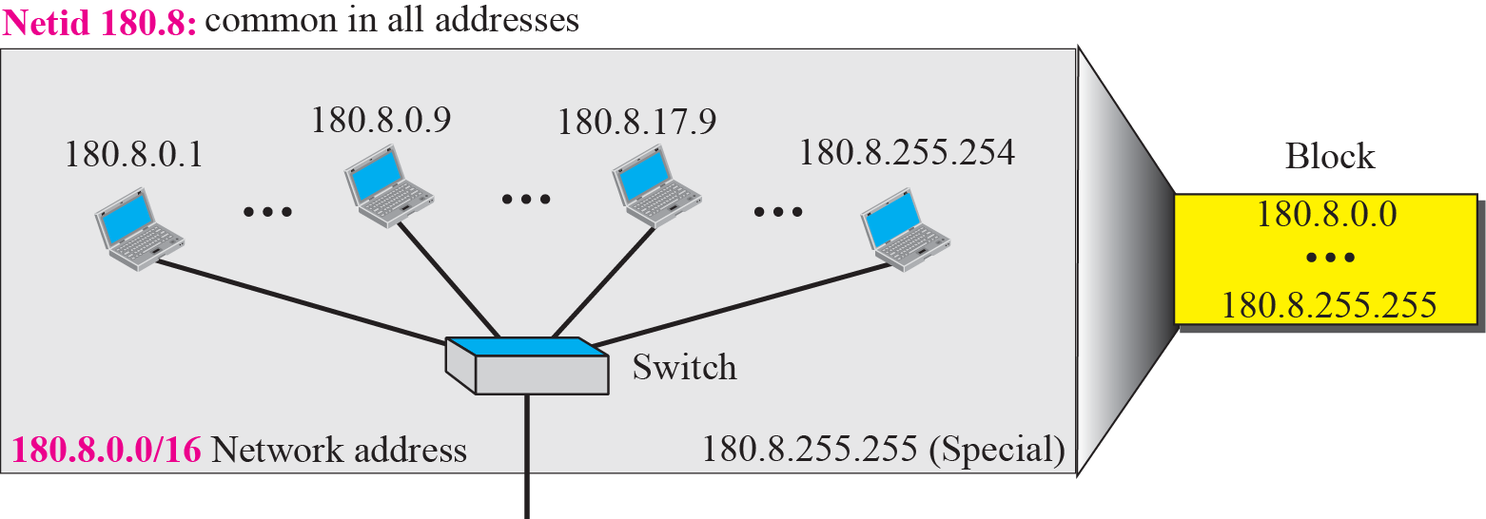
Figure 5.17 Solution to Example 5.14

Slide 43
Example 5.15
An address in a block is given as 200.11.8.45. Find the number of addresses in the block, the first address, and the last address.
Solution
Figure 5.17 shows a possible configuration of the network that uses this block.
1. The number of addresses in this block is N = 2^{32−n} = 256.
2. To find the first address, we keep the leftmost 24 bits and set the rightmost 8 bits all to 0s. The first address is 200.11.8.0/16, in which 24 is the value of n.
3. To find the last address, we keep the leftmost 24 bits and set the rightmost 8 bits all to 1s. The last address is 200.11.8.255/16.
Notes:
192~223，C类地址

Slide 44
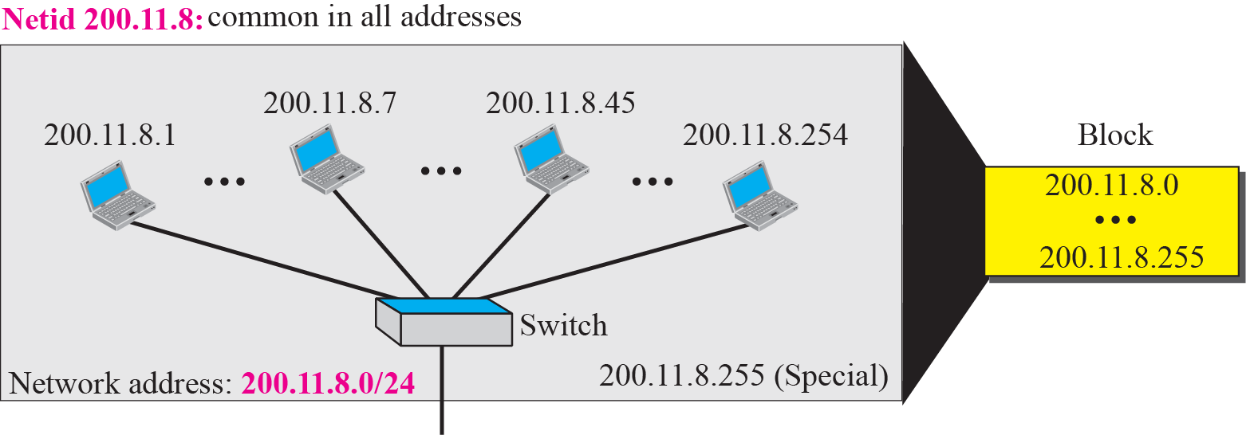
Figure 5.18 Solution to Example 5.15

Slide 45
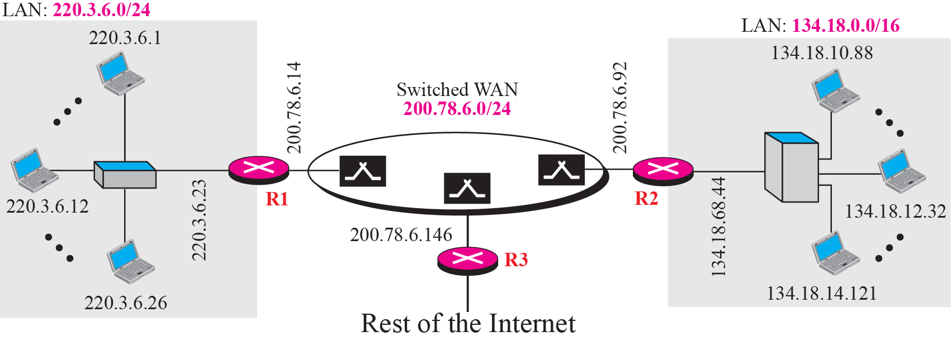
Figure 5.19 Sample Internet
An example
Notes:
不同网络间的互联实例，两端的局域网各自有一个逻辑地址(相同网络)，中间网络有一个逻辑地址

Slide 46
How To manage the logical address of every network？
Note
The network address is the identifier of a network.
Notes:
通过统一的网络地址编址，实现了异构网络的互联

Slide 47
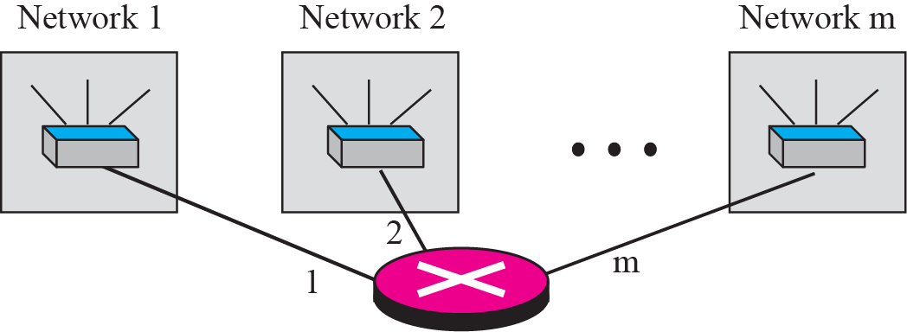
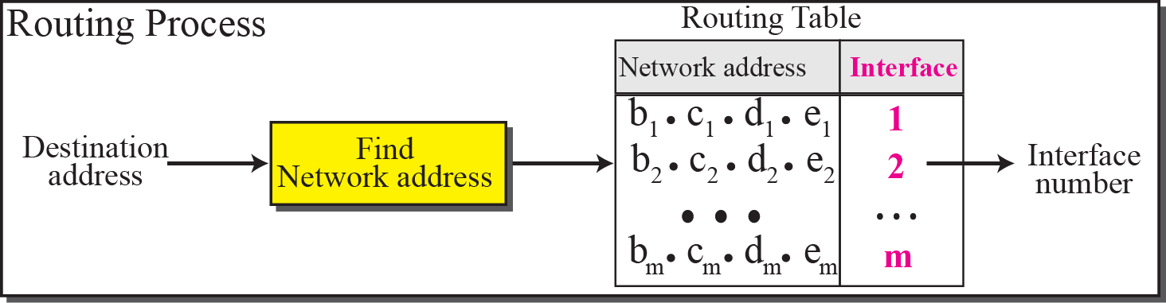
Figure 5.20 Network addresses

Slide 48
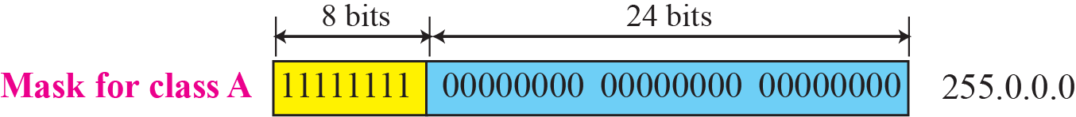
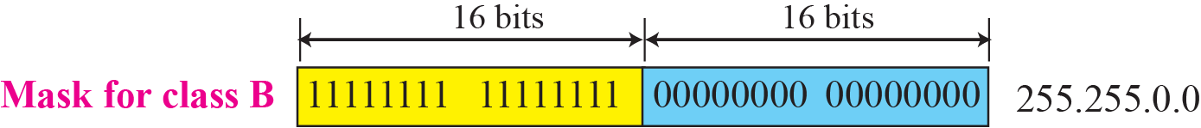
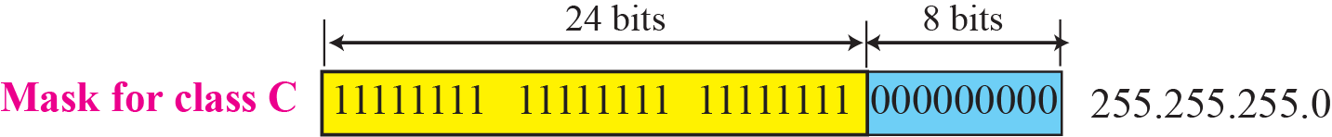
Figure 5.21 Network mask
Notes:
因为一个网络单元拥有1个网络地址，所以直接用网络地址进行寻址，只取网络地址的运算是通过掩码实现的

Slide 49
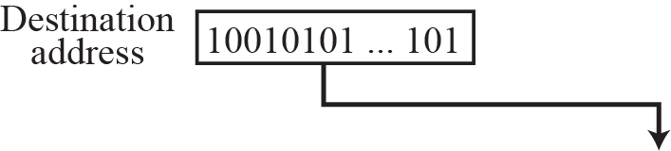
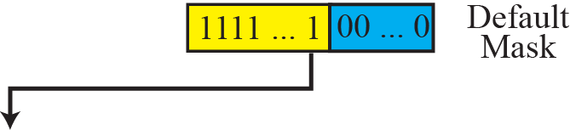
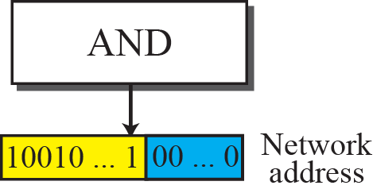
Figure 5.22 Finding a network address using the default mask

Slide 50
Example 5.16
A router receives a packet with the destination address 201.24.67.32. Show how the router finds the network address of the packet.
Solution
Since the class of the address is B, we assume that the router applies the default mask for class B, 255.255.0.0 to find the network address.

Slide 51
Example 5.17
Three-level addressing can be found in the telephone system if we think about the local part of a telephone number as an exchange and a subscriber connection:
in which 626 is the area code, 358 is the exchange, and 1301 is the subscriber connection.

Slide 52
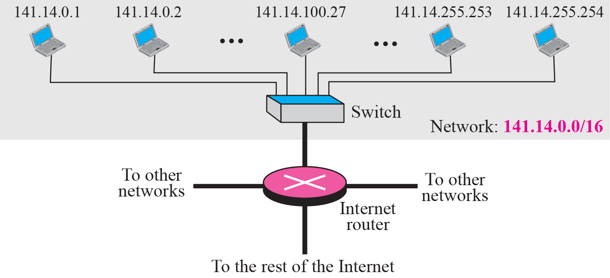
Example 5.18
Figure 5.23 shows a network using class B addresses before subnetting. We have just one network with almost 2¹⁶ hosts. The whole network is connected, through one single connection, to one of the routers in the Internet. Note that we have shown /16 to show the length of the netid (class B).

Slide 53
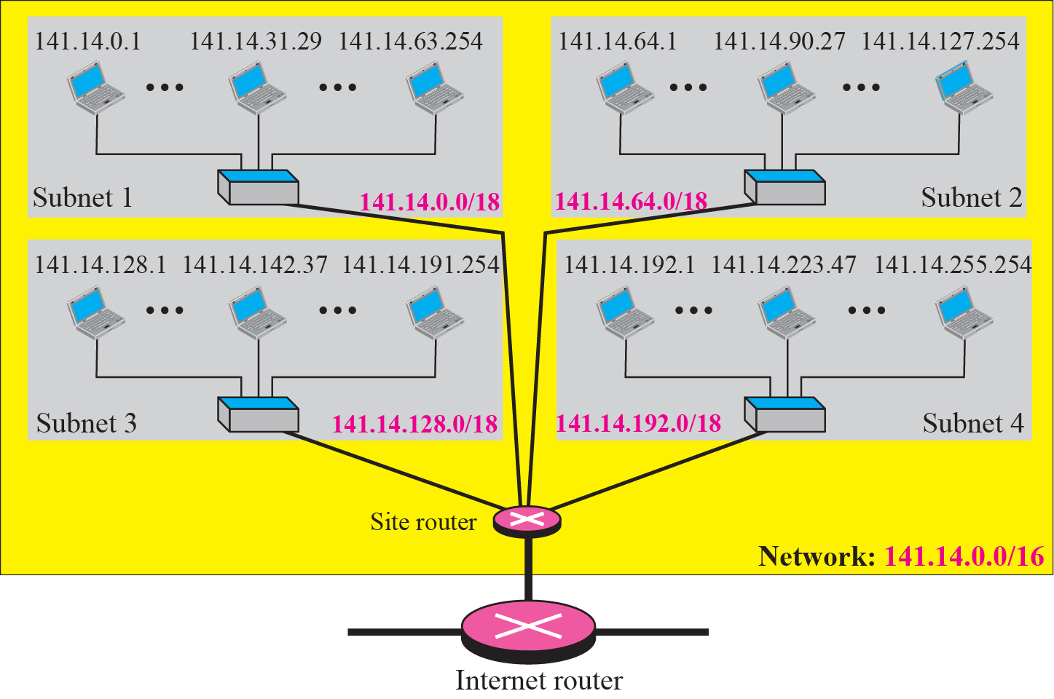
Figure 5.24 Example 5.19
Figure 5.24 shows the same network in Figure 5.23 after subnetting. The whole network is still connected to the Internet through the same router. However, the network has used a private router to divide the network into four subnetworks.
Notes:
第3字节高2个bits，128，64， 00，01就是64，10是128，11是192

Slide 54
Figure 5.24 Example 5.19
The rest of the Internet still sees only one network; internally the network is made of four subnetworks. Each subnetwork can now have almost 2¹⁴ hosts.

Slide 55
Figure 5.24 Example 5.19
The network can belong to a university campus with four different schools (buildings). After subnetting, each school has its own subnetworks, but still the whole campus is one network for the rest of the Internet. Note that /16 and /18 show the length of the netid and subnetids.

Slide 56
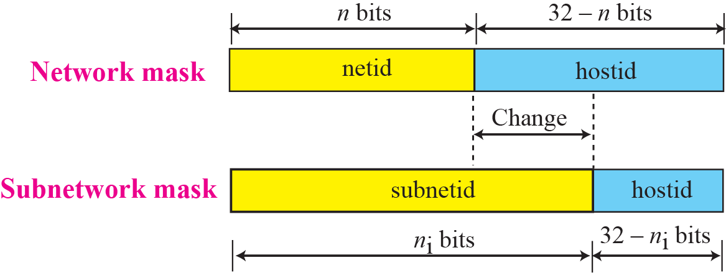
Figure 5.25 Network mask and subnetwork mask

Slide 57
Example 5.20
In Example 5.19, we divided a class B network into four subnetworks. The value of n = 16 and the value of
n₁ = n₂ = n₃ = n₄ = 16 + log₂4 = 18.
This means that the subnet mask has eighteen 1s
and fourteen 0s. In other words, the subnet mask is 255.255.192.0 which is different from the network mask for class B (255.255.0.0).

Slide 58
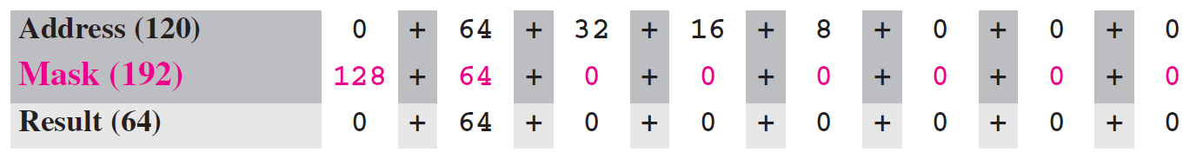
Example 5.21
In Example 5.19, we show that a network is divided into four subnets. Since one of the addresses in subnet 2 is 141.14.120.77, we can find the subnet address as:
The values of the first, second, and fourth bytes are calculated using the first short cut for AND operation. The value of the third byte is calculated using the second short cut for the AND operation.

Slide 59
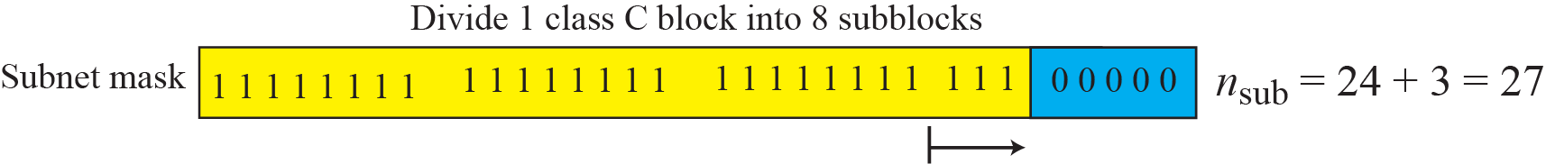
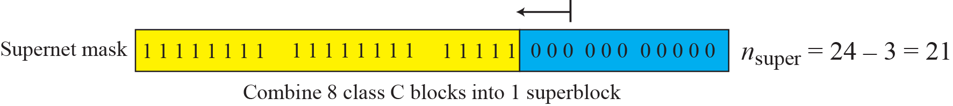
Figure 5.26 Comparison of subnet, default, and supernet mask

Slide 60
Chapter Outline
5.1 Introduction
5.2 Classful Addressing
5.3 Classless Addressing
5.4 Special Addresses
5.5 NAT

Slide 61
5-3 CLASSLESS ADDRESSING
Subnetting and supernetting in classful addressing did not really solve the address depletion problem. With the growth of the Internet, it was clear that a larger address space was needed as a long-term solution. Although the long-range solution has already been devised and is called IPv6, a short-term solution was also devised to use the same address space but to change the distribution of addresses to provide a fair share to each organization. The short-term solution still uses IPv4 addresses, but it is called classless addressing.
Notes:
资源耗尽问题的2个解决方案，IPv6 和IPv4无分类编址

Slide 62
Topics Discussed in the Section
Variable –Length Blocks
Two-Level Addressing
Block Allocation
Subnetting

Slide 63
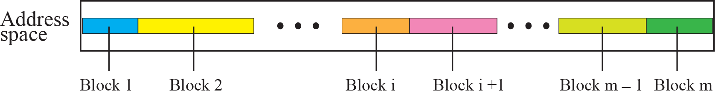
Figure 5.27 Variable-length blocks in classless addressing

Slide 64
Note
In classless addressing, the prefix defines the network and the suffix
defines the host.

Slide 65
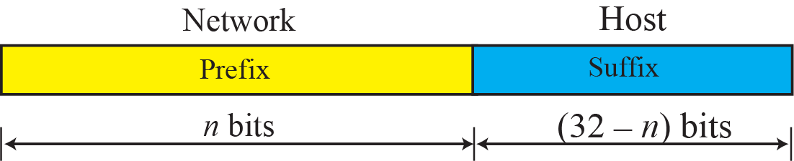
Figure 5.28 Prefix and suffix

Slide 66
Note
The prefix length in classless addressing can be 1 to 32.

Slide 67
Example 5.22
What is the prefix length and suffix length if the whole Internet is considered as one single block with 4,294,967,296 addresses?
Solution
In this case, the prefix length is 0 and the suffix length is 32. All 32 bits vary to define 2³² = 4,294,967,296 hosts in this single block.

Slide 68
Example 5.23
What is the prefix length and suffix length if the Internet is divided into 4,294,967,296 blocks and each block has one single address?
Solution
In this case, the prefix length for each block is 32 and the suffix length is 0. All 32 bits are needed to define 2³² = 4,294,967,296 blocks. The only address in each block is defined by the block itself.

Slide 69
Example 5.24
The number of addresses in a block is inversely related to the value of the prefix length, n. A small n means a larger block; a large n means a small block.

Slide 70
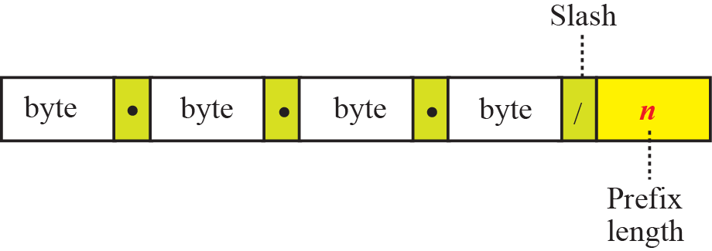
Figure 5.29 Slash notation

Slide 71
Note
In classless addressing, we need to know one of the addresses in the block
and the prefix length to define the block.

Slide 72
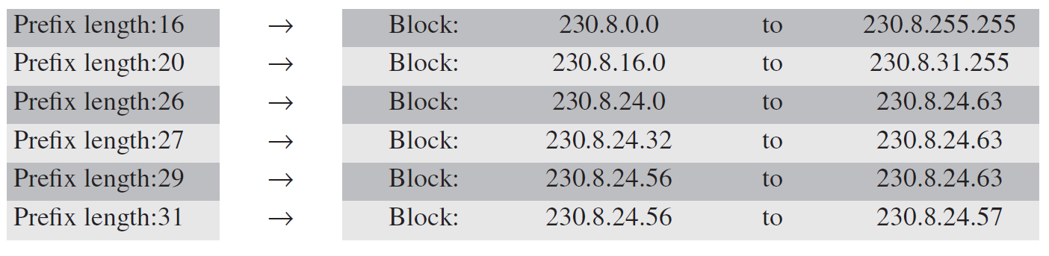
Example 5.25
In classless addressing, an address cannot per se define the block the address belongs to. For example, the address 230.8.24.56 can belong to many blocks some of them are shown below with the value of the prefix associated with that block:

Slide 73
Example 5.26
The following addresses are defined using slash notations.
a. In the address 12.23.24.78/8, the network mask is 255.0.0.0. The mask has eight 1s and twenty-four 0s. The prefix length is 8; the suffix length is 24.
b. In the address 130.11.232.156/16, the network mask is 255.255.0.0. The mask has sixteen 1s and sixteen 0s.The prefix length is 16; the suffix length is 16.
c. In the address 167.199.170.82/27, the network mask is 255.255.255.224. The mask has twenty-seven 1s and five 0s. The prefix length is 27; the suffix length is 5.

Slide 74
Example 5.27
One of the addresses in a block is 167.199.170.82/27. Find the number of addresses in the network, the first address, and the last address.
Solution
The value of n is 27. The network mask has twenty-seven 1s and five 0s. It is 255.255.255.240.
a. The number of addresses in the network is 2^{32 − n} = 32.
b. We use the AND operation to find the first address (network address). The first address is 167.199.170.64/27.

Slide 75
Example 5.27 Continued
c. To find the last address, we first find the complement of the network mask and then OR it with the given address: The last address is 167.199.170.95/27.

Slide 76
Example 5.28
One of the addresses in a block is 17.63.110.114/24. Find the number of addresses, the first address, and the last address in the block.
Solution
The network mask is 255.255.255.0.
a. The number of addresses in the network is 2³² ⁻ ²⁴ = 256.
b. To find the first address, we use the short cut methods discussed early in the chapter. The first address is 17.63.110.0/24.

Slide 77
Example 5.28 Continued
c. To find the last address, we use the complement of the network mask and the first short cut method we discussed before. The last address is 17.63.110.255/24.

Slide 78
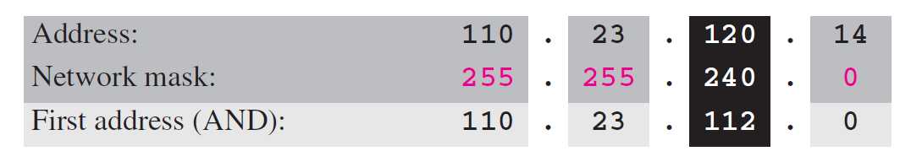
Example 5.29
One of the addresses in a block is 110.23.120.14/20. Find the number of addresses, the first address, and the last address in the block.
Solution
The network mask is 255.255.240.0.
a. The number of addresses in the network is 2³² ⁻ ²⁰ = 4096.
b. To find the first address, we apply the first short cut to bytes 1, 2, and 4 and the second short cut to byte 3. The first address is 110.23.112.0/20.

Slide 79
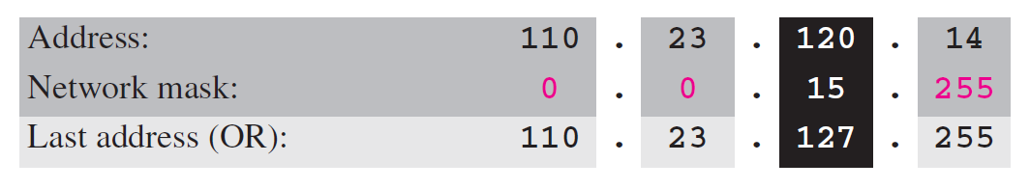
Example 5.29 Continued
c. To find the last address, we apply the first short cut to bytes 1, 2, and 4 and the second short cut to byte 3. The OR operation is applied to the complement of the mask. The last address is 110.23.127.255/20.

Slide 80
Example 5.30
An ISP has requested a block of 1000 addresses. The following block is granted.
a. Since 1000 is not a power of 2, 1024 addresses are granted (1024 = 210).
b. The prefix length for the block is calculated as n = 32 − log₂1024 = 22.
c. The beginning address is chosen as 18.14.12.0 (which is divisible by 1024).
The granted block is 18.14.12.0/22. The first address is 18.14.12.0/22 and the last address is 18.14.15.255/22.

Slide 81
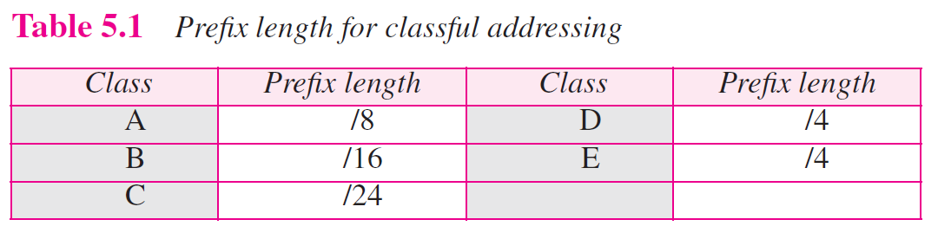

Slide 82
Example 5.31
Assume an organization has given a class A block as 73.0.0.0 in the past. If the block is not revoked by the authority, the classless architecture assumes that the organization has a block 73.0.0.0/8 in classless addressing.

Slide 83
Note
The restrictions applied in allocating addresses for a subnetwork are
parallel to the ones used to allocate addresses for a network.

Slide 84
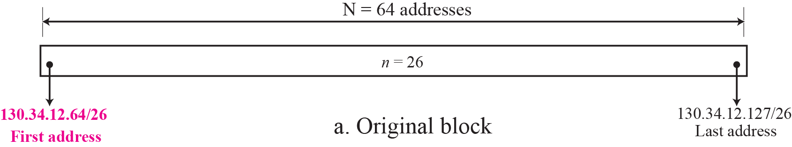
Example 5.32
An organization is granted the block 130.34.12.64/26. The organization needs four subnetworks, each with an equal number of hosts. Design the subnetworks and find the information about each network.

Slide 85
Example 5.32
An organization is granted the block 130.34.12.64/26. The organization needs four subnetworks, each with an equal number of hosts. Design the subnetworks and find the information about each network.
Solution
The number of addresses for the whole network can be found as N = 2³² ⁻ ²⁶ = 64. The first address in the network is 130.34.12.64/26 and the last address is 130.34.12.127/26. We now design the subnetworks:
1. We grant 16 addresses for each subnetwork to meet the first requirement (64/16 is a power of 2).
2. The subnetwork mask for each subnetwork is:

Slide 86
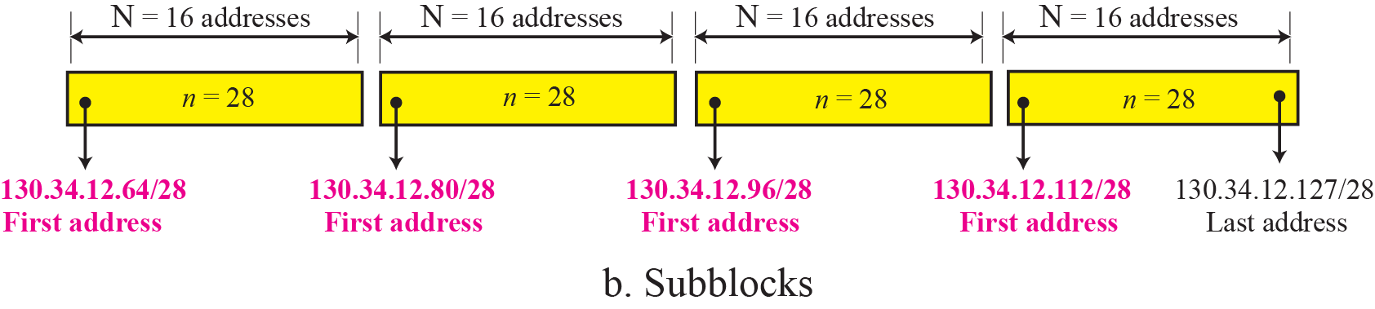
Example 5.32 Continued
3. We grant 16 addresses to each subnet starting from the first available address. Figure 5.30 shows the subblock for each subnet. Note that the starting address in each subnetwork is divisible by the number of addresses in that subnetwork.

Slide 87
Example 5.33
An organization is granted a block of addresses with the beginning address 14.24.74.0/24. The organization needs to have 3 subblocks of addresses to use in its three subnets as shown below:
❑ One subblock of 120 addresses.
❑ One subblock of 60 addresses.
❑ One subblock of 10 addresses.
Solution
There are 2³² ⁻ ²⁴ = 256 addresses in this block. The first address is 14.24.74.0/24; the last address is 14.24.74.255/24.
a. The number of addresses in the first subblock is not a power of 2. We allocate 128 addresses. The subnet mask is 25. The first address is 14.24.74.0/25; the last address is 14.24.74.127/25.

Slide 88
Example 5.33 Continued
b. The number of addresses in the second subblock is not a power of 2 either. We allocate 64 addresses. The subnet mask is 26. The first address in this block is 14.24.74.128/26; the last address is 14.24.74.191/26.
c. The number of addresses in the third subblock is not a power of 2 either. We allocate 16 addresses. The subnet mask is 28. The first address in this block is 14.24.74.192/28; the last address is 14.24.74.207/28.
d. If we add all addresses in the previous subblocks, the result is 208 addresses, which means 48 addresses are left in reserve. The first address in this range is 14.24.74.209. The last address is 14.24.74.255.
e. Figure 5.31 shows the configuration of blocks. We have shown the first address in each block.

Slide 89
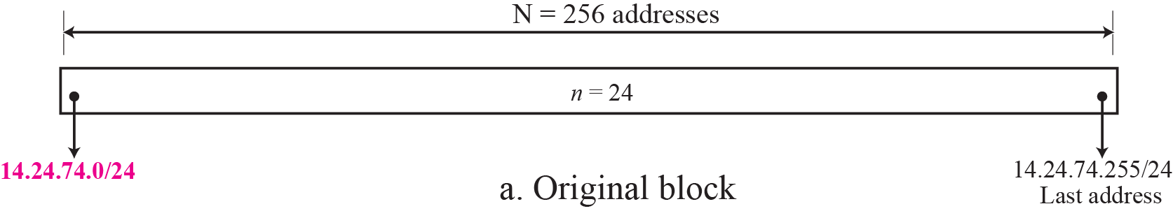
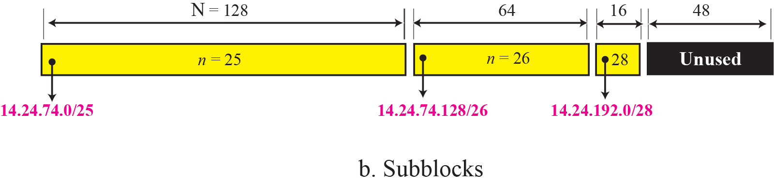
Figure 5.31 Solution to Example 5.33

Slide 90
Example 5.34
Assume a company has three offices: Central, East, and West. The Central office is connected to the East and West offices via private, WAN lines. The company is granted a block of 64 addresses with the beginning address 70.12.100.128/26. The management has decided to allocate 32 addresses for the Central office and divides the rest of addresses between the two other offices.
1. The number of addresses are assigned as follows:
2. We can find the prefix length for each subnetwork:

Slide 91
Example 5.34 Continued
3. Figure 5.32 shows the configuration designed by the management. The Central office uses addresses 70.12.100.128/27 to 70.12.100.159/27. The company has used three of these addresses for the routers and has reserved the last address in the subblock. The East office
uses the addresses 70.12.100.160/28 to 70.12.100.175/28. One of these addresses is used for the router and the company has reserved the last address in the subblock. The West office uses the addresses 70.12.100.160/28 to 70.12.100.175/28. One of these addresses is used for the router and the company has reserved the last address in the subblock. The company uses no address for the point-to-point connections in WANs.

Slide 92
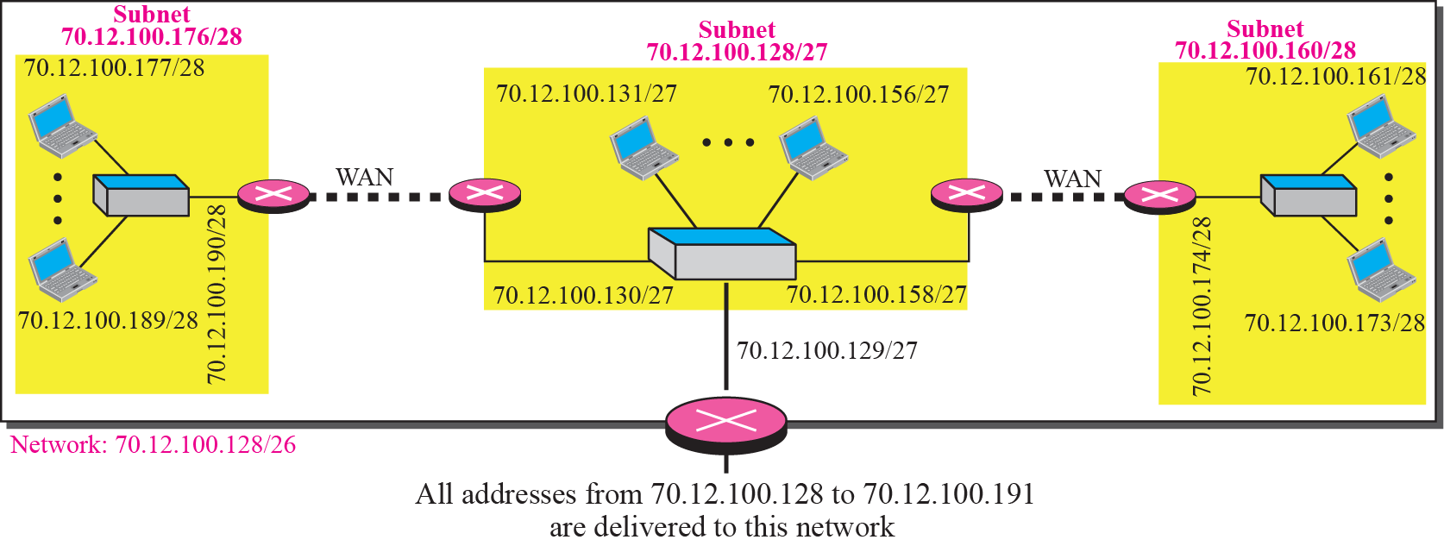
Figure 5.32 Example 5.34

Slide 93
Example 5.35
An ISP is granted a block of addresses starting with 190.100.0.0/16 (65,536 addresses). The ISP needs to distribute these addresses to three groups of customers as follows:
❑ The first group has 64 customers; each needs approximately 256 addresses.
❑ The second group has 128 customers; each needs approximately 128 addresses.
❑ The third group has 128 customers; each needs approximately 64 addresses.
We design the subblocks and find out how many addresses are still available after these allocations.

Slide 94
Example 5.35 Continued
Solution
Let us solve the problem in two steps. In the first step, we allocate a subblock of addresses to each group. The total number of addresses allocated to each group and the prefix length for each subblock can found as
Figure 5.33 shows the design for the first hierarchical level. Figure 5.34 shows the second level of the hierarchy. Note that we have used the first address for each customer as the subnet address and have reserved the last address as a special address.

Slide 95
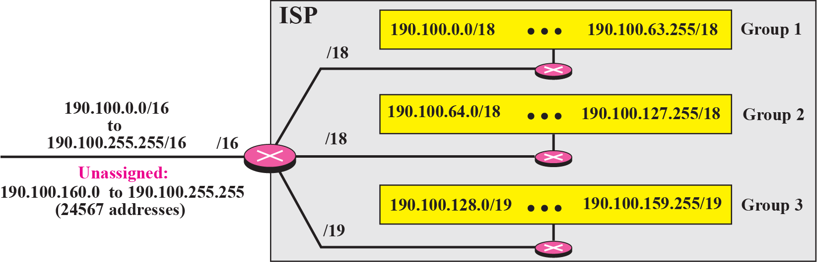
Figure 5.33 Solution to Example 5.35: first step

Slide 96
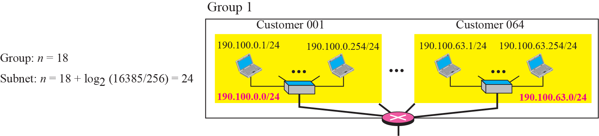


Figure 5.34 Solution to Example 5.35: second step

Slide 97
Chapter Outline
5.1 Introduction
5.2 Classful Addressing
5.3 Classless Addressing
5.4 Special Addresses
5.5 NAT

Slide 98
5-4 SPECIAL ADDRESSES
In classful addressing some addresses were reserved for special purposes. The classless addressing scheme inherits some of these special addresses from classful addressing.

Slide 99
Topics Discussed in the Section
Special Blocks
Special Addresses in each Block

Slide 100
5.4 Special Addresses
Special Address | Netid | Hostid | Source or Destination
Network address | Specific | All 0s | none
Direct broadcast address | Specific | All 1s | Destination
Limited broadcast address | All 1s | All 1s | Destination
This host on this network | All 0s | All 0s | Source
Specific host on this network | All 0s | Specific | Destination
Loopback address | 127 | any | Destination
Specific—— neither all 1s nor all 0s

Slide 101
Network Address
标识网络
网络地址
123.65.7.34
Netid
Hostid
123.50.16.90
Specific
All 0s
123.90.123.4
Class A
123.0.0.0
216.45.7.20
Class C
216.45.7.0
149.14.0.0
Class B
149.14.27.8
216.45.7.64
149.14.67.64
216.45.7.126
149.14.45.9

Slide 102
Direct broadcast address
Netid
Hostid
直接广播地址
Specific
All 1s
216.45.7.64
216.45.7.20
216.45.7.126
标识对特定网络的广播
Destination
216.45.7.255
216.45.7.0
149.14.45.9
Hostid
Destination
216.45.7.255
149.14.0.0
Netid
149.14.67.64
149.14.27.8

Slide 103
Figure 5.38 Example of a directed broadcast address
Notes:
Limited broadcast is the broadcast limited to a single LAN and which is to be received by all. It is sent to reserved Class E , IP address 255.255.255.255. The destination MAC address for such frames will be FF:FF:FF:FF:FF:FF. The router simply drop the Limited broadcast address and does not forward it. Directed Broadcast address is the local subnet broadcast address. If the subnet is 192.168.10.0 , the directed broadcast address will be 192.168.10.255 , which will be heard by all in the same subnet hosts. The router will receive such packet and process it. The destination mac address will still be FF:FF:FF:FF:FF:FF, as it is to be received by all hosts. DHCP packets are Limited broadcast packets and NBNS uses directed broadcast packets.

Slide 104
Limited broadcast address
标识对本地网络的广播
255.255.255.255
受限广播地址
216.45.7.64
216.45.7.20
216.45.7.126
Destination
255.255.255.255
216.45.7.0
Destination
255.255.255.255
blocked
149.14.45.9
149.14.0.0
Destination
255.255.255.255
149.14.67.64
149.14.27.8

Slide 105
Figure 5.36 Example of limited broadcast address
Notes:
局域广播地址

Slide 106
This host on this network
本网络上的本主机
0 . 0 . 0 . 0
? . ? . ? . ?
216.45.7.126
Bootstrap Server
（DHCP Server）
216.45.7.0
Source：0.0.0.0
Destination：255.255.255.255

Slide 107

Figure 5.35 Example of using the all-zero address

Slide 108
Loopback address
回送地址
127 . X . Y . Z
测试本机器软件
Process 1
Process 2
TCP or UDP
216.45.7.20
IP
Network Access
216.45.7.0
Destination
127 . X . Y . Z

Slide 109
Figure 5.37 Example of loopback address

Slide 110
Specific host on this network
Netid
Hostid
本网络上的特定主机
All 0s
Specific
216.45.7.64
216.45.7.126
216.45.7.20
216.45.7.0
Destination
0 . 0 . 0 . 64
Destination
0 . 0 . 0 . 64
Netid
Hostid

Slide 111
Private Addresses
Private network（私有网，专用网）
不需接入Internet，但需要用TCP/IP通信
Addressing Scheme
申请，并使用A、B、C类地址
不申请，直接使用A、B、C类地址
不申请，直接使用私有地址
Private address（私有地址，专用地址）
全网唯一
本网唯一
全网不唯一
类 | 私有地址 | 总数
A | 10.0.0.0~10.255.255.255 | 1 * A
B | 172.16.0.0~172.31.255.255 | 16 * B
C | 192.168.0.0~192.168.255.255 | 256 * C

Slide 113
Discussion 1: Router & IP Network
路由器的一个接口能否接在两个IP网上？
路由器的多个接口能否接在一个IP网上？
能
Net 1
Net 2
不能
→ 路由器：3层设备，基于IP地址转发
IP地址—— 网络层，标识网络连接
逻辑而非物理

Slide 114
Discussion 2: Multihomed Devices
Multihomed host（多接口主机）
Can be attached to one or more networks
One interface one IP address
Router（路由器）
Must connect to more than one networks
One interface one IP address
123.5.16.90
123.0.0.0
205.67.71.2
123.7.9.11
205.67.7.0
141.14.0.0
141.14.6.80
141.14.22.9

Slide 115
Discussion 3: P2P WAN
Point-to-Point WAN
“为节省地址，不给点到点WAN指派网络地址”——《TCP/IP协议族》第2版第91页
Unnumbered p2p line: the network interfaces connected to this line do not have IP addresses
The IP architecture: traditionally assumed that all interfaces have IP addresses
2 solutions（RFC 1812 section 2.2.7）
Consider the unnumbered p2p line to be an internal bus in a virtual router —— 2 important drawbacks
Use router-id (one of the router’s IP addresses) to be the IP address of all unnumbered interfaces
Sample: ip unnumbered command on cisco router
"borrows" the IP address from a different LAN interface
Notes:
一个接口如果没有IP地址就无法生成路由也就无法产生IP报文，转发报文。所谓IP unnumbered 就是路由器一个接口上没有配置IP地址但是还想使用该接口那么就直接利用本地某接口网络地址作为该接口的网络地址以使该接口能够正常使用

Slide 116
Sample Internet
129.8.14.12
134.18.6.1
134.18.0.0
129.8.0.0
129.8.0.1
220.3.6.2
222.13.16.3
220.3.6.1
134.18.1.1
220.3.6.0
222.13.16.23
134.18.4.9
134.18.1.7
222.13.16.0
201.2.5.1
201.2.5.0
P2P WAN
201.2.5.2
222.13.16.1
124.0.0.0
124.42.33.77
124.42.5.45
124.42.51.45

Slide 117
Unicast, Multicast, and Broadcast Address
Unicast（单播）
Communication：one-to-one，Source or destination address
Every node in the Internet must has at least one unique unicast address
Example：Class A, B, and C
Multicast（多播）
Communication：one-to-many，Only destination address
A node in the Internet can has one or more multicast address
Example：Class D
Broadcast（广播）
Communication：one-to-all，Only destination address
Example：direct or limited broadcast address

Slide 118
Chapter Outline
5.1 Introduction
5.2 Classful Addressing
5.3 Classless Addressing
5.4 Special Addresses
5.5 NAT

Slide 119
5-5 NAT
The distribution of addresses through ISPs has created a new problem. If the business grows or the household needs a larger range, the ISP may not be able to grant the demand because the addresses before and after the range may have already been allocated to other networks. In most situations, however, only a portion of computers in a small network need access to the Internet simultaneously. A technology that can help in this cases is network address translation (NAT).

Slide 120
Topics Discussed in the Section
Address Translation
Translation Table

Slide 121

Figure 5.39 NAT

Slide 122
Figure 5.40 Address resolution

Slide 123

Figure 5.41 Translation

Slide 124
NAT Table with only IP addresses (1)
1 global address
1 private
P1 → D1
G1 → D1
NAT Table for G1
P1
D1
D1
D1 → P1
D1 → G1
different external hosts
1 global address
P1 → D1
NAT Table for G1
G1 → D1
2 privates
P2 → D2
P1
D1
G1 → D2
D1
P2
D2
D1 → P1
D1 → G1
D2
D2 → P2
D2 → G1

Slide 125
NAT Table with only IP addresses (2)
Same external host
1 global address
P1 → D1
NAT Table for G1
G1 → D1
2 privates
P2 → D1
P1
D1
G1 → D1
P2
D1
D1
？？？
D1 → G1
？？？
D1 → G1
Same external host
2 global addresses
P1 → D1
NAT Table for G1
G1 → D1
D1 → P1
P1
D1
D1 → G1
2 privates
P2 → D1
NAT Table for G2
G2 → D1
D1
D1 → P2
P2
D1
D1 → G2

Slide 126
NAT Table with only IP addresses (3)
If using only one global address
Only one private-network host to access the same external host
If using a pool of global addresses (e.g. 4 addr)
No more than 4 connections can be made to the same destination
No private-network host can access two external server programs (e.g. HTTP and TELNET) at the same external host at the same time ???
Two private-network hosts cannot access the same external server program at the same time (by using the same global address)

Slide 127
NAT Table with IP address & Port # (1)
Same external host
(Telnet)
1 global address
NAT Table for G1
P1:#1→D1:#23
P1:#1
G1:#1
G1:#1→D1:#23
P1:#2→D1:#23
P1:#2
G1:#2
G1:#2→D1:#23
3 privates
P2:#1→D1:#23
P2:#1
G1:#3
G1:#3→D1:#23
P3:#1→D1:#23
P3:#1
G1:#4
G1:#4→D1:#23
Must be unique
D1:#23→P1:#1
D1:#23→G1:#1
D1:#23→P1:#2
D1:#23→G1:#2
D1
D1:#23→P2:#1
D1:#23→G1:#3
D1:#23→P3:#1
D1:#23→G1:#4

Slide 128

NAT Table with IP address & Port # (2)
Must be unique

Slide 129

NAT Table with IP address & Port # (3)

Slide 130
NAT Table with IP address & Port # (4)
NAT Table in the textbook
This may not be the best way to understand NAT
Server
Must be unique
Otherwise reassign a new private port and cache the mapping (the new port --> the old port)

Slide 131
Chapter Outline
5.1 Introduction
5.2 Classful Addressing
5.3 Classless Addressing
5.4 Special Addresses
5.5 NAT

Slide 132
Reading
Internet Protocol
https://tools.ietf.org/html/rfc791
Internet Addresses
https://tools.ietf.org/html/rfc796
https://tools.ietf.org/html/rfc917
Notes:
六

Slide 133
Thanks

